Slide 1
Basel IV implications
Support for discussion
March 2024

Slide 3
1
Basel IV overview

Slide 4
EXECUTIVE SUMMARY
Basel IV¹ it’s completing its approval process at EU level, in December 2023 the Council of European Union confirmed the final compromises text expected to be a quasi-final version of the regulation which will enter into force from January 2025
Compliance with new Regulation will challenge Banks throughout the organization with emphasis on management of RWA inflation and of Data model lifecycle
RWA inflation is primarily led by 3 factors:
The introduction of an output floor, limiting the RWA benefits from IRB models in comparison with the overall RWA under the standardized approach
The introduction of relevant changes to IRB models and parameters
New RWA methodologies and asset classes for standard approach
Enhanced Data capabilities are among key success factors to manage RWA inflation and, at the same time, under the spotlight of ECB that set compliance with BCBS239 has a 2023-2025 priority
In this context there are no doubt about the importance for Banks to start assessing Basel 4 implications on capital and profitability, identifying opportunities to mitigate RWA inflation (for both standard and Internal models), to strengthen data strategy and to launch targeted and well-informed implementation program
1. Also referred to as “Basel 3.1” or the “Revised Basel III framework”; 2. Non-exhaustive list, see appendix for full list of changes

Slide 5
Basel IV is completing its approval process at EU level
Context
Timeline
The European Commission published the Banking Package 2021 implementing the standards approved by the Basel Committee at the end of 2017. The text of the law was approved, albeit with changes compared to the Committee's proposal, by the European Parliament. In December 2023, the Council published a new proposal that integrate the feedbacks from the European Parliament
The announcement comprises of proposals to amend banking sector legislation i.e., the Capital Requirements Regulation (CRR 3) and Capital Requirements Directive (CRD VI)
The finalization of the process of adjustment to Basel III (the so-called “Basel IV”), partly started in recent years and with the aim of further strengthening the framework for calculating capital requirements, making it more risk sensitive, provides for the full adjustment of the systems risk measurement and underlying processes starting from 1 January 2025
Oct-21
On 27th October 2021, the European Commission published Banking Package 20211
On 25th January 2023, the European Parliament approved the text, albeit with changes compared to the Commission proposal
Jan-23
In December 2023, the Council published a new proposal that integrate the feedbacks from the European Parliament
DEC-23
Today
On 1st January 2025, the new regulation will be applied to EU banks – Expected date included in approved text, still to be confirmed
Jan-25
On 1st January 2030, the phase-in of the new regulation will be completed, and the new rules will be applied in full (e.g., IRB floor) – Expected date included in approved text, still to be confirmed
Jan-30

Slide 6
Across impacted areas, credit risk and output floor is where risk management has broader margin of interventions
Key elements
Impact estimates of the Basel IV implementation for European banks (December 2021)
After phase-in
Credit, market and operational risk are the areas with the highest (negative) expected impact in terms of capital consumption
For Banks using internal models the output floor is clearly an aspect to tackle to reduce excessive changes on capital consumption thus on profitability
Expectations on RWAs inflation are optimistic as they assume fully fledged implementation and full data availability – but this not a quick win and ex-ante in depth analysis are required to identify optimal solutions across business, data and processes
Change in Minimum
required capital (MRC), %
Figures not based on the final version, but still relevant from materiality perspective
6.8
-0.6
-1.1
1.7
11.8
0.4
10.7
1.8
1.5
0.2
Credit risk STD
Credit risk IRB
Market risk
CVA
Op risk
Output floor
Other adjsutments
Total Risk-based
Leverage Ratio
Total
Source: EBA, Basel III monitoring exercise – results based on data as of 31 December 2021 (Annex – analysis of EU specific Adjustments)

Slide 7
2
optimization levers

Slide 8
We see three types of levers that can be deployed to reduce capital absorption and developing capital-light strategies
Focus of below is on Credit Risk aspects, however we have a long list of levers for any risk type
technical levers
Strategic Actions on Models
Supporting Other Strategic Choices
RWA optimization levers on the current portfolio of a technical or managerial nature to minimize capital absorption, for example:
Technical levers on data quality, methodology for RWA optimization, etc..
Eligibility of collateral for portfolios moving to Foundation approach
Mapping of Basel IV CCFs and reduction of unused lines
Optimizing customer segmentation logic according to Basel IV rules
Methodological choice in the context of evolutions of the standardized approach
Review of criteria for CET1 capital deduction
…
Strategic choices in the context of using models, for example:
Evaluation on developing IRB models for specific asset classes of your portfolio (e.g., exposures secured by Mortgages)
Decommissioning of internal model featuring low benefits
Feasibility assessment of SRT approach (in parallel with strategic choices in this area)
…
Support in addressing strategic choices, e.g
Commercial approach to undrawn lines of credit (business strategy and pricing)
Review of product offerings
Review of credit strategies/standards (e.g., collateral requirements)
Identification of risk transfer opportunities (originate-to-distribute models, insurance, synthetic securitizations)
Definition of ex-ante capital allocation logic and active credit portfolio management
…
Oliver Wyman can provide a unique mix of expertise that combines knowledge of the technicalities of the underlying RWA calculation, business and capital management actions, and an integrated offering for structured finance transactions, in collaboration with our sister companies Marsh and Guy Carpenter

Slide 9
There are opportunities for rwa optimization for many of main regulatory changes - illustrative example
Shortlist of levers – not exhaustive
Area |  | Key highlights | Levers to de deployed |  |  | Deep-dive reference
 |  |  | Technical levers | Strategic actions on models | Other strategic choices
A | Output floor for internal models RWAs | Total RWAs from internal models floored at 72.5% of SA RWAs The floor for the purposes of the group ratio calculated at the highest level of consolidation in the EU Phase-in from 2025 (floor at 50%) with a 5% annual increase to 2030 (last year increase of 2.5%) |  |  |  | Slides 10-11
B | Revision of the CCFs |  |  |  |  | Slides 12
C | CCF estimation approach | CCF must be floored to 0 before taking the averages for calibration purposes (negative CCF can be used for risk differentiation purposes) |  |  |  | Slide 13
D | Effective maturity | Effective maturity (instead of regulatory) can be used also in case of F-IRB approach |  |  |  | Slide 14
E | LGD | LGD floors introduced under A-IRB approach Unsecured LGD decreased from 45% to 40% for non-financial corporates |  |  |  | Slide 15
Products: | SA | F-IRB | B IV
Unconditionally cancellable comm. | 0% | 0% | 10%
Other commitments | 20-50% | 75% | 40%
RUF and NIF¹ | 50% | 75% | 50%
See full list of credit risk RWA changes in Appendix 1
1. Revolving Underwriting Facilities and Note Issuance Facility

Slide 10
The Output floor limits the amount of capital benefit from use of internal models to 27.5% (on bank-level)
A
Output floor concept
Illustration of output floor (aggregated across all risk types)
The final Basel III framework (a.k.a. Basel IV) introduces an aggregate output floor (on bank-level) to the calculation of RWA by means of internal models
The rule provides that RWA must be calculated as the maximum of
the total risk-weighted assets calculated using the approaches that the bank has supervisory approval to use in accordance with the Basel capital framework (including both standardised and internally-modelled based approaches) and
72.5% of the total risk-weighted assets, calculated using only the standardised approaches […]’
As a result, the revised output floor limits the amount of capital benefit a bank can obtain from its use of internal models, relative to using the standardised approaches
According to the provisions of the Basel III reform package, there will be a 5-year transitional period for the implementation of the output floor, according to which the level of the floor, i.e., the percentage of the non-modelled RWA, will gradually increase from 50% in 2025 to the fully phased-in level of 72.5% in 2030
100,0
Fully phased-in
72,5
With standardised approach
With internal models
 | 2025 | 2026 | 2027 | 2028 | 2029 | 2030
Output floor | 50% | 55% | 60% | 65% | 70% | 72.5%
Output floor
Output floor add-on
RWAs

Slide 11
To (partially) mitigate the impact of output floors, the accuracy of standardised capital calculation needs to be increased
A
Considerations
RWA optimization of SA portfolio
List of levers based on recent Oliver Wyman project example – shortlist not exhaustive
Many peers already compute the capital requirement under STD approach, even for IRB-validated portfolios
However, these calculations are often not optimized or not entirely correct (given no direct implication on capital requirements)
With the output floors introduced, this needs to change as the STD approach offers several levers to optimize the result incl.
Segmentation review
Collateral / guarantee recognition
Extend use of ECAI ratings
Dependency on other ongoing remediation activities
1
Update/recovery of real estate appraisals
High
2
Subscription of insurance coverage on real estate
1
3
Inventory of properties as collateral
2
3
4
Use of ECAI ratings for the "Corporate" segment
5
Use of ECAI ratings for the "Supervised Entities" segment
Feasible with external providers
6
Forcing eligibility questionnaires for real estate
5
4
7
Update of financial data
Implementation complexity
8
Review of rating grades for Financial Institutions
9
Forcing segmentation from "Corporate" to "Retail"
Manageable centrally or with already planned actions
10
Application of SME SF for balance sheet recovery
11
Recognition of offset agreements for derivatives
12
Extension of policy for eligibility of personal guarantees
11
12
13
Recognition of collateral for OTC derivatives
Low
6
8
9
10
13
7
Low
Estimated RWA savings
High

Slide 12
BASEL IV REVISIONS TO CCF WILL ELIMINATE THE CURRENT DIFFERENCES BETWEEN STANDARDIZED VS. IRB TREATMENT
B
CCF harmonization in Basel IV
Implications
Items | Current SA CCF¹ | Current IRB CCF² | Post Basel IV³
Direct credit substitutes, e.g., general guarantees Sale and repurchase agreements and asset sales where credit risk remains with the bank The lending of banks’ securities or the posting of securities as collateral by banks Forward asset purchases, forward deposits and partly paid shares and securities Off-balance sheet items that are credit substitutes not included in any other category | 100% | 100% | 100%
Certain transaction-related contingent items | 50% | 50% | 50%
Both the issuing and confirming banks of short-term⁴ self-liquidating trade letters of credit arising from the movement of goods | 20% | 20% | 20%
Note issuance facilities and revolving underwriting facilities regardless of the maturity of the underlying facility | 50% | 75% | 50%
Commitments, unless they qualify for a lower CCF⁵ | 20% =< 1yr 50% > 1yr | 75% | 40%
Commitments that are unconditionally cancellable at any time by the bank without prior notice, or that effectively provide for automatic cancellation due to deterioration in a borrower’s creditworthiness | 0% | 0% | 10%
As current regulations (Basel III) entails 0% CCF for unconditionally cancellable commitments, peers typically assign high limits under the premise that these limits can be cancelled at any point in time
However, in Basel IV, these off-balance exposures will be assigned a 10% CCF for F-IRB and SA exposures (corresponding to a minimum 5% for A-IRB exposures due to the input floors)
This enforces peers to more thoroughly define their limit-setting framework as it sparks a trade-off between (i) high limits with low utilization, leading to increased RWs; and (ii) low limits with high utilization, leading to missed revenue opportunities
As a mitigation action it is suggested to (i) review which business offers with an unconditionally cancellable line will still be profitable under the new regulation and (ii) define new business/ contractual rules
1. www.bis.org/basel_framework/chapter/CRE/20.htm?inforce=20191215&published=20191215#paragraph_CRE_20_20191215_20_35 (paragraph 20.36-20.45); 2. www.bis.org/basel_framework/chapter/CRE/32.htm (paragraphs 32.2-32.5) 3. www.bis.org/bcbs/publ/d424.pdf (pages 25- 27, 71)
4. Short-term in this context means with a maturity below one year
5. Note - Where there is an undertaking to provide a commitment on an off-balance sheet item, banks are to apply the lower of the two CCFs

Slide 13
Data remediation program will help banks to mitigate consequences of negative CCF flooring at 0 rule proposed in basel IV
C
Regulation update
Illustrative
Possible consequence and mitigation approach
For the purpose of quantification of IRB-CCF estimates, if institutions observe negative realised conversion factor on their default observations, the realised conversion factor on these observations shall be floored to zero
Institutions may use the information of the negative realised conversion factor in the process of model development for the purpose of risk differentiation
CCF distribution
Average pre-floor
Average CCF
Negative values included: 30%
Negative values floored at 0: 60%
Average post-floor
0
CCF
CCF distribution is usually wide, with a material part distribute on negative values.
As average CCF will inevitably increase due to flooring of all negative observation at 0, the only approach to mitigate it is a full review of negative CCF cases using the following steps: Launch data remediation process to review negative and positive CCF values in historic data Fix input data if observed CCFs are results of errors or inaccuracies. Where possible, merge observations of the same customer getting a netting effect Update data collection and processing procedures to minimize inconsistencies and errors going forward This is a massive exercise, but it is required to obtain a sustainable CCF level for revolving products. Based on the results, further strategic actions on the model can be evaluated (for example update the model in order to introduce new drivers to limit the effect of the new target variable)

Slide 14
Basel IV revisions to Effective maturity application will make a-irb banks to consider switching to f-irb models
D
CRR article 162(1) - referring to Maturity calculation for F-IRB
Decision making & implementation
Institutions that have not received permission to use own LGDs and own conversion factors for exposures to corporates, institutions or central governments and central banks (…) Alternatively, as part of the permission referred to in Art. 143 (about permission to use the IRB approach), the competent authorities shall decide on whether the institution shall use maturity (M) for each exposure as set out under paragraph 2 (of Art 162)
For exposures for which an institution has not received permission of the competent authority to use own estimates of LGD, the maturity value (‘M’) shall be applied consistently and, either be set at 2,5 years, except for exposures arising from securities financing transactions, for which M shall be 0,5 years or, alternatively, be calculated in accordance with paragraph 2 (of Art 162)
Assess impact of using effective maturity instead of regulatory maturity for all portfolios
currently using F-IRB
that will move to F-IRB in the near future (either via validating from STD or reverting to a less sophisticated approach from A-IRB)
Evaluate overall convenience of choice
Develop a robust plan for transition to F-IRB approach for selected portfolios, including data, processes, infrastructure and other changes required
Current regulation
Basel IV revision
Note that the decision may also affect open decisions about model validation, potentially making F-IRB approach more convenient than in the past
Article 494d provides explicit possibility to revert to a less sophisticate approach within 3 years after the application of the new regulation.
Reviewed article 148 allows to validate only some exposure classes, without requesting PPU

Slide 15
Basel IV will introduce LGD floors under A-IRB and lgd decrease for unsecured non-financial corporates alongside other parameters change under f-irb
E
Corporate/Retail minimum LGD values in Basel IV¹ under A-IRB
Corporate LGD value changes in Basel IV under F-IRB approach
Segment(s) | BIII floor | BIV floor
Corporate: Unsecured | NA | 25%
Corporate: Secured – Financials | NA | 0%
Corporate: Secured – Receivables | NA | 10%
Corporate: Secured – RRE/CRE | NA | 10%
Corporate: Secured – Other | NA | 15%
Retail: Unsecured – QRRE transactions | NA | 50%
Retail: Unsecured – QRRE revolver | NA | 50%
Retail: Unsecured – Other | NA | 30%
Retail: Secured – Mortgage | 10% | 5%
Retail: Secured – Financials | NA | 0%
Retail: Secured – Receivables | NA | 10%
Retail: Secured – RRE/CRE | NA | 10%
Retail: Secured – Other | NA | 15%
Segment(s) | BIII LGD unsecured | BIV LGD unsecured
Unsecured – Senior claims on sovereigns, banks, securities firms and other financial institutions | 45% | 45%
Unsecured – Senior claims on other (non-financial) corporates² | 45% | 40%
Unsecured – Subordinated claims | 75% | 75%
Segment(s) | BIII LGD secured | BIV LGD secured | BIII Collateral HC | BIV Collateral HC
Secured – Financials | 0% | 0% | - | Non-static¹
Secured – Receivables | 35% | 20% | 20% | 40%
Secured – RRE / CRE | 35% | 20% | 28.6% | 40%
Secured – Other | 40% | 25% | 28.6% | 40%
Secured – Ineligible collateral | NA | NA | NA | 100%
Following introduced changes in LGD values for both A-IRB and F-IRB approaches banks should assess benefits of transition from A-IRB and Standard approach to F-IRB
1. Given the enhancements to the framework and the introduction of an output floor, the 1.06 scaling factor that is currently applied to RWAs will be removed. 2. Senior exposures without FCP to PSE-RGLAs will maintain the old LGD value of 45%

Slide 16
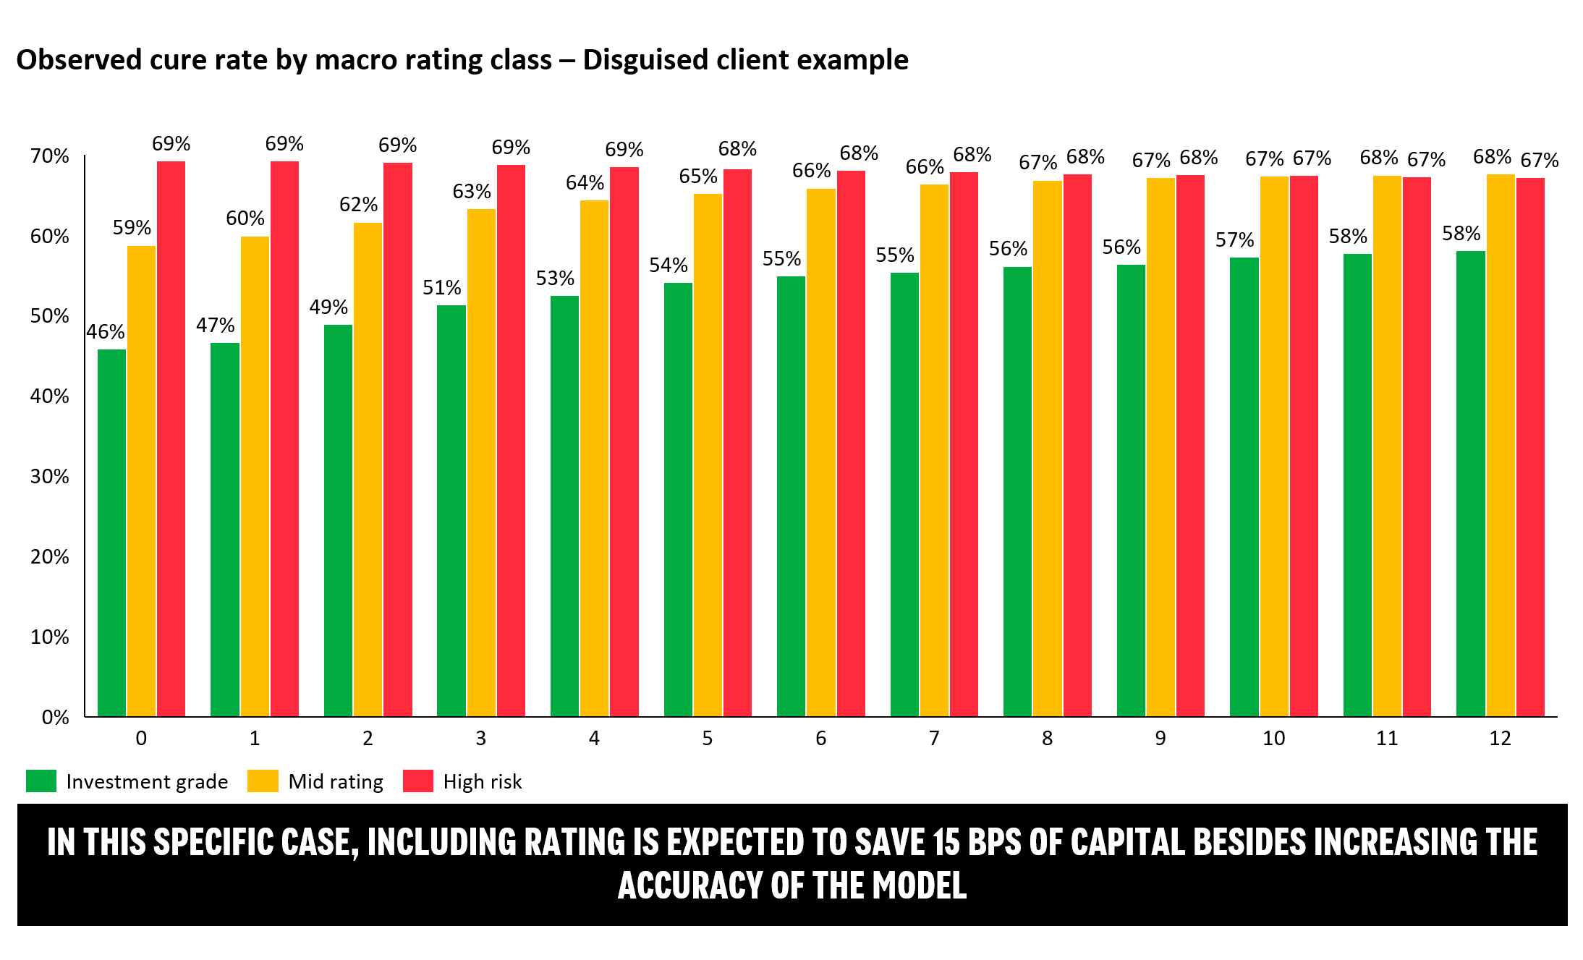
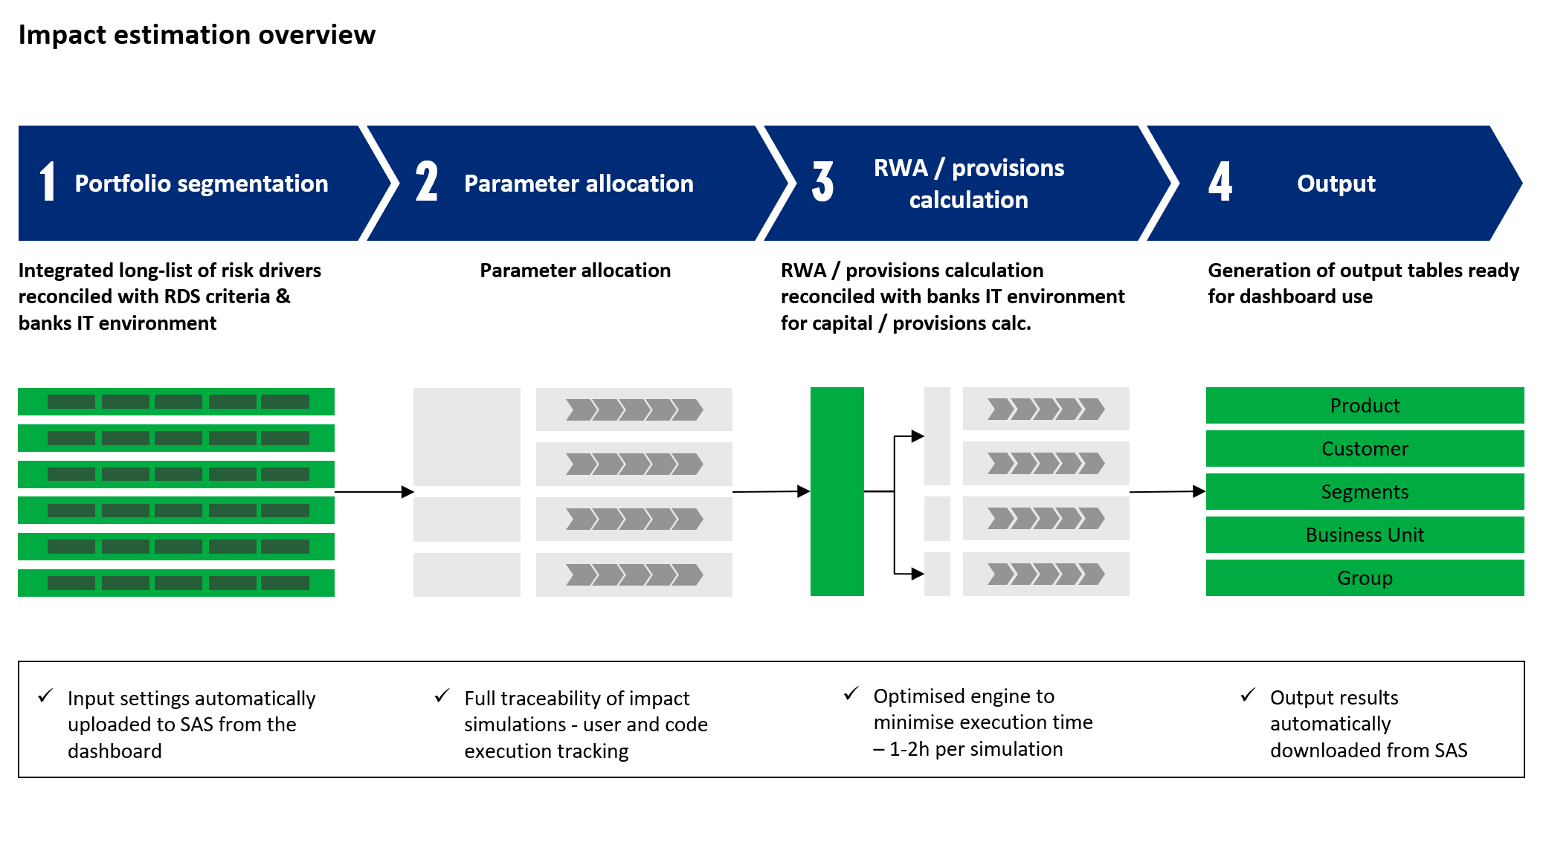
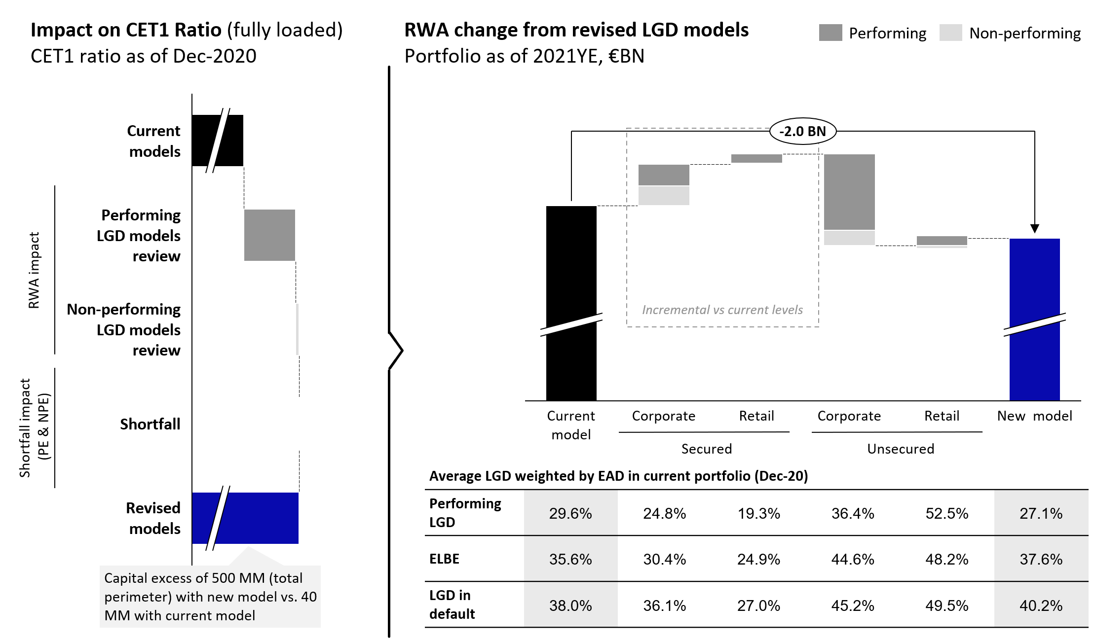
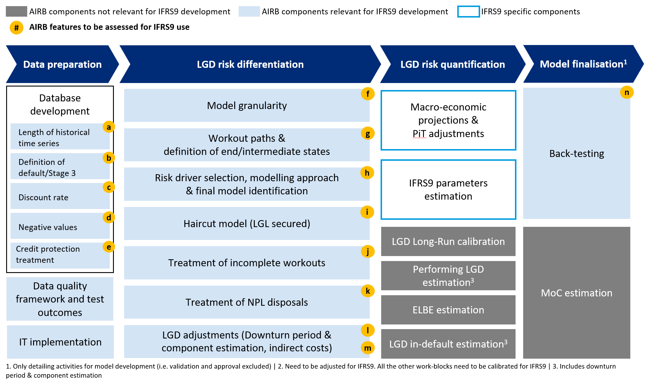
Case study – DEVELOPMENT AND implementation of IRB rwa/CET1 “in-vitro” calculation system for SSM bank
A
DEFINITION OF ROLES and OWNERSHIP ACROSS THE PROCESS
Impact assessment for key PD/LGD/CCF model parameters and components (e.g., MoC, risk drivers, risk quantification)
1-2h hours of run time allows testing alternative IRB models methodologies/sensitivities
B
Definition of quality assurance controls
Development of “in-vitro” RWA simulation tool
High accuracy of RWA/CET1 impacts – results of the simulation tool differ from the official ones by a margin of 1-2%
Comparison of alternative scenarios vs. 'Official' scenario to support the Supervisory dialogue and prepare defense strategies
C
Implementation of rwa-accuracy levers on the official rwa system
D

